Slide 1
Analysis of Distribution System Operation Functions
ECpE Department
Zhaoyu Wang
1113 Coover Hall, Ames, IA
wzy@iastate.edu

Slide 2
Analysis of Distribution System Operation Functions
Acknowledgement:
The slides are developed based in part on Electric Power and Energy Distribution Systems, Models, Methods and Applications, Subrahmanyan S. Venkata, Anil Pahwa, IEEE Press & Wiley, 2022
ECpE Department

Slide 3
Overview
Implementation of distribution automation functions requires thoughtful planning and analysis.
Specific details, such as the data requirements and algorithms to arrive at a decision are important.
This slide deck examines in detail of distribution automation functions.
ECpE Department

Slide 4
1. Outage Management
Outage management is crucial for utility companies' reputation and performance.
Scrutiny by the public, press, and governing bodies is triggered if performance falls below a certain standard.
Power restoration after an interruption must be prompt to avoid financial losses, inconvenience, and customer dissatisfaction.
Studies show that even residential customers experience costs associated with power outages.
Restructuring of the power industry emphasizes the significance of outage management.
ECpE Department

Slide 5
1. Outage Management
State corporation commissions require utilities to submit annual reports on outages.
Performance-based rates and penalties motivate utilities to improve outage management.
Better performance leads to positive publicity and increased customer loyalty.
Outage management system tasks: fault location, fault isolation, and service restoration.
Fault location can be determined using real-time measurements from protective devices or other devices installed at a strategic location on the system.
ECpE Department

Slide 6
1. Outage Management
New techniques based on voltage sag and current rise are being developed.
Peer-to-peer communication among devices and with the control center enhances fault location.
Outage location can also be based on information gathered from customers’ premises from smart meters or customer calls.
Outage management takes on a different meaning for utilities in the event of major storms (tornadoes, hurricanes, ice storms).
Normal utility operations cease, and all resources are focused on repairing the system and restoring power.
Thousands of customers can be affected by storm-related outages.
ECpE Department

Slide 7
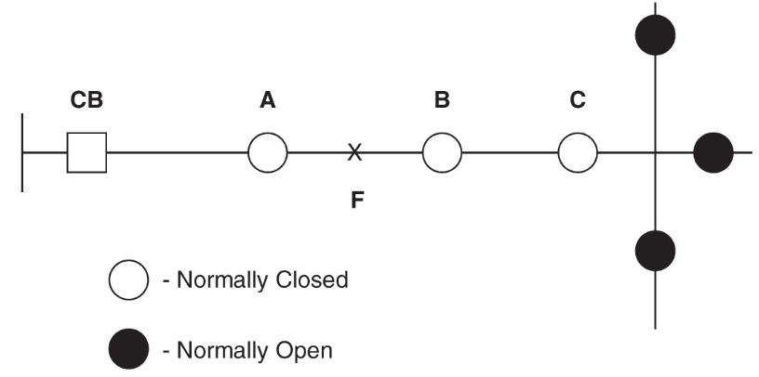
1. Outage Management
Illustration of outage location, fault isolation, and restoration of a system
A feeder in Fig.1 is configured with automated and communication enabled circuit breakers (CB) and sectionalizers (A, B, C, D, E, F).
Fault occurrence at ‘F’ can be seen by circuit breaker CB, and sectionalizer A, but sectionalizers B and C do not see it.
CB and sectionalizer A open, and A signals sectionalizer B (next down stream device) to open.
D
E
F
Fig. 1 An automated figure with outage location, fault isolation, and restoration capabilities.
Actually, before A opens, CB already reclosed twice to confirm it is a permanent fault, and A counts this CB operations.
ECpE Department

Slide 8
1. Outage Management
Illustration of outage location, fault isolation, and restoration of a system
Following this, CB recloses to restore power to the line section between CB and sectionalizer A.
However, line sections between sectionalizer B and the normally open sectionalizers D, E, F are healthy but do not have power.
Control action initiated to close one of D, E, F to restore power to healthy parts of the feeder.
D
E
F
Fig. 1 An automated figure with outage location, fault isolation, and restoration capabilities.
ECpE Department

Slide 9
1. Outage Management
Illustration of Outage Location, Fault Isolation, and restoration of a system
Several Rules are followed to determine which open sectionalizer (D, E, F) to close for power restoration such as:
D
E
F
Identify the path with the highest spare capacity, either from the same transformer or another transformer.
Ensure that the feeders in the selected path are not overloaded.
Fig. 1 An automated figure with outage location, fault isolation, and restoration capabilities.
ECpE Department

Slide 10
1. Outage Management
Illustration of Outage Location, Fault Isolation, and restoration of a system
Several Rules are followed to determine which open sectionalizer (D, E, F) to close for power restoration such as:
D
E
Monitor and maintain voltages within the limits defined by the American National Standards Institute (ANSI).
Minimize the number of switching operations to optimize the restoration process.
F
Fig. 1 An automated figure with outage location, fault isolation, and restoration capabilities.
ECpE Department

Slide 11
1. Outage Management
The above approach works well for faults on three-phase main feeders, it is impractical to apply it for faults on laterals.
Laterals are typically single-phase feeders, which are protected by fuses.
Replacing fuses by an automated remote-controlled sectionalizer for every lateral in the system is cost prohibitive.
Laterals do not have a tie point at the end to connect to other feeders.
Hence, techniques based on information from customers, such as trouble call analysis, are the best to locate faults on laterals.
Cost-prohibitive to replace fuses with remote-controlled sectionalizers on every lateral.
ECpE Department

Slide 12
1. 1 Trouble Call Analysis
Trouble call analysis relies on customer calls to locate outages.
Advances in telecommunications technology have improved the process.
Number of customer calls varies depending on time of day and weather conditions. Night time outages receive fewer calls, impacting the accuracy of fault location. Initial call volume increases gradually for about 30 minutes during stormy conditions. Calls decrease significantly after approximately 90 minutes of prolonged outage.
ECpE Department

Slide 13
1. 1 Trouble Call Analysis
Utilities now dedicate multiple phone lines for customers to report outages.
Web interfaces and phone databases allow customers to enter outage information.
Data from customer calls is processed and displayed on system maps for fault location.
In addition, trouble call analysis system monitors the progress of restoration and provides customers feedback on expected length of the outage.
ECpE Department

Slide 14
1. 1 Trouble Call Analysis
Automated retrieval of outage information from AMI provides additional insights.
AMI primarily focuses on metering with no real-time feedback for operations.
AMI collects energy consumption data periodically and sends it to a billing services company’s server.
AMI can have a feature to report outages directly to the utility or through a third party.
Communication bottlenecks may occur if a large number of meters report outages simultaneously, loss of data is possible.
ECpE Department

Slide 15
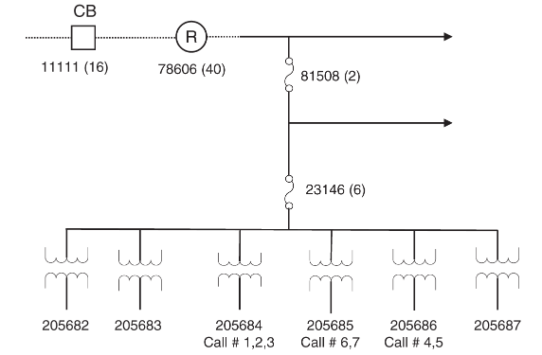
1.1.1 Outage Location using Escalation Methods
Outage report escalation method utilizes reported interruptions to identify a common point of electrical connectivity.
Analysis starts from extreme downstream points and moves upstream.
In Fig. 2, the number below transformers indicate the number of customer calls received for each transformer, parentheses indicate the total number of downstream devices at each level.
Fig. 2 One-Line diagram of part of a typical distribution systems
ECpE Department

Slide 16
1.1.1 Outage Location using Escalation Methods
For example, Device 78606 is a recloser and Level 1 device. It has 40 Level 2 devices (lateral fuses) downstream.
Calls associated with transformer 205684 suggest a problem with that specific transformer.
Fig. 2 One-Line diagram of part of a typical distribution systems
ECpE Department

Slide 17
1.1.1 Outage Location using Escalation Methods
Similarly, calls associated with transformers 205685 and 205686 indicate issues with those transformers.
Considering these calls independently implies separate problems with each transformer, which is unlikely.
Another possibility is a problem in the upstream feeder, affecting customers downstream from it.
Fig. 2 One-Line diagram of part of a typical distribution systems
ECpE Department

Slide 18
1.1.1 Outage Location using Escalation Methods
The other possibility is that there is a problem in the feeder upstream which is causing all the customers connected downstream from it to lose power, even though no calls were received from customers connected to transformers 205682, 205683, and 205687.
Fig. 2 One-Line diagram of part of a typical distribution systems
ECpE Department

Slide 19
1.1.2 Rule-Based Escalation
Protective devices within the distribution system are designated different levels based on their locations. All primary feeder circuit breakers and reclosers are designated as Level 1 devices.
Fuses connected to the primary side of distribution transformers are designated as Level 3 devices.
Fig. 2 One-Line diagram of part of a typical distribution systems
ECpE Department

Slide 20
1.1.2 Rule-Based Escalation
All protective devices between Level 1 and Level 3 are designated as Level 2 devices. This generally includes the lateral fuses serving the laterals.
In Fig. 2, 11111 and 78606 are Level 1, 81508 and 23146 are Level 2, and 205683, 205684, 205686 are Level 3.
Fig. 2 One-Line diagram of part of a typical distribution systems
ECpE Department

Slide 21
1.1.2 Rule-Based Escalation
The state of protective devices can be either "0" for normal or "1" if suspected to have operated.
The state of Level 1 devices (recloser or a circuit breaker) changes to "1" if the specified threshold percentage of devices connected directly beneath it have their state changed to "1.”
Fig. 2 One-Line diagram of part of a typical distribution systems

Slide 22
1.1.2 Rule-Based Escalation
Level 2 devices (lateral fuses) change to "1" if the specified threshold percentage of devices connected directly beneath it have their state changed to "1.“
Level 3 devices are the distribution level transformer fuses, and a single call from a customer served by it changes its state to “1.”
Fig. 2 One-Line diagram of part of a typical distribution systems

Slide 23
1.1.2 Rule-Based Escalation
The process of call escalation starts by changing the state of Level 3 devices associated with received calls to “1”.
Any subsequent calls that are received from customers served by the same device will not affect its state.
Fig. 2 One-Line diagram of part of a typical distribution systems
ECpE Department

Slide 24
1.1.2 Rule-Based Escalation
After processing all the registered calls, the state of the Level 2 devices is determined, followed by the state of Level 1 devices.
Once the states of all devices are determined, calls are grouped based on the state of devices that have their state changed to "1" and do not have any other device upstream with a state of "1."
Fig. 2 One-Line diagram of part of a typical distribution systems
ECpE Department

Slide 25
1.1.2 Rule-Based Escalation
Further, the probability of two separate outages in a time frame is lower than one outage and the probability decreases as larger number of outages are considered.
Hence, for Level 2 devices (lateral fuses), which typically do not have many devices downstream, using a high value for threshold could result in calls not getting grouped together and instead would be assigned to several lower level devices.
Fig. 2 One-Line diagram of part of a typical distribution systems
ECpE Department

Slide 26
1.1.2 Rule-Based Escalation
In a radial distribution feeder, Level 1 devices will have larger number of immediate downstream devices.
Therefore, a lower threshold value for Level 1 devices can group calls together during normal weather conditions, indicating a single outage.
Fig. 2 One-Line diagram of part of a typical distribution systems
ECpE Department

Slide 27
1.1.2 Rule-Based Escalation
On the other hand, a higher threshold value for Level 1 devices, calls would not get grouped together, and an outage on the main feeder could be considered as multiple outage on laterals.
The threshold number seems paradoxical, as it should be low as well as high. Important factors on which this threshold could depend are weather conditions.
Fig. 2 One-Line diagram of part of a typical distribution systems
ECpE Department

Slide 28
1.1.2 Rule-Based Escalation
Under normal weather conditions, the chance of more than one outage occurring within the same time period is relatively low. During such conditions, if calls that are associated with multiple devices are received, it is very likely that a main feeder circuit breaker upstream of the call origin would have operated.
Hence, a lower threshold value for Level 1 devices would make it possible to classify the incoming calls in a single group.
Fig. 2 One-Line diagram of part of a typical distribution systems
ECpE Department

Slide 29
1.1.2 Rule-Based Escalation
On the other hand, during stormy conditions, the likelihood of multiple outages increases.
Therefore, under such conditions, a relatively higher threshold value for Level 1 devices would ascertain that the calls are not classified into a single group.
Fig. 2 One-Line diagram of part of a typical distribution systems
ECpE Department

Slide 30
1.1.2 Rule-Based Escalation
Thus, the threshold value of Level 1 devices has to be chosen as a trade‐off between allowing multiple outages to be classified into different groups during rough weather conditions while also allowing calls to be grouped together during normal conditions.
The best way to achieve this would be to set a variable threshold that is changed between certain ranges depending on the weather conditions.
Fig. 2 One-Line diagram of part of a typical distribution systems
ECpE Department

Slide 31
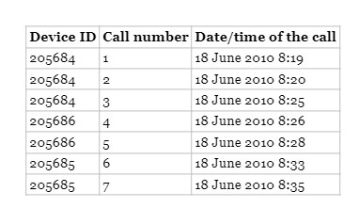
1.1.2 Test Cases
The distribution circuit configuration and call record data were obtained from a utility in Kansas for the test cases.
In addition, a list of operated protective devices that were discovered by the field restoration crew associated with each call sequence was obtained.
The calls received within one and a half hours after the first call are considered for processing, while calls received after this period are considered separate instances of outages.
The system configuration for the first case is shown in Figure 2.
Table 1 presents the log of calls received during the outage.
Fig. 2 One-Line diagram of part of a typical distribution systems
Table 1: Calls log of 18 June 2010
ECpE Department

Slide 32
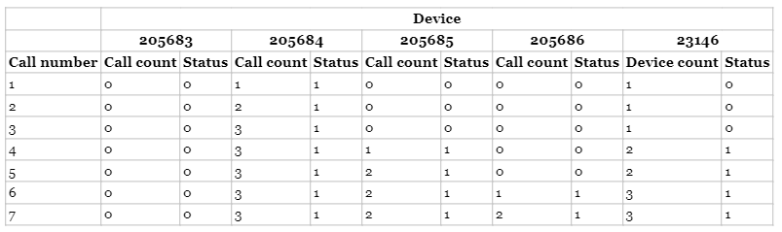
1.1.2 Test Cases
Table 2: Escalation Calls and status of device
Table 2 shows escalation of calls and their impacts on the status of the devices.
Fuses 205683, 205684, 205685, and 205686 are fuses and thus Level 3 devices, which change status even with one call.
ECpE Department

Slide 33
1.1.2 Test Cases
Table 2: Escalation Calls and status of device
Note that 205682 and 205687 did not have any calls and are not listed in Table 1.
Fuse 23146 is a Level 2 device, and its status changes after more than 20% of the devices below it change their status to 1.
After the fourth call, two devices below 23146 become 1, exceeding the 20% threshold, causing its status to change to 1.
ECpE Department

Slide 34
1.1.2 Test Cases
Table 2: Escalation Calls and status of device
Additional calls do not change the status of any other Level 2 or Level 1 devices.
This implies that all the calls belong to one group, which are associated with device 23146.
It was also reported as the operated protective device by the utility.
ECpE Department

Slide 35
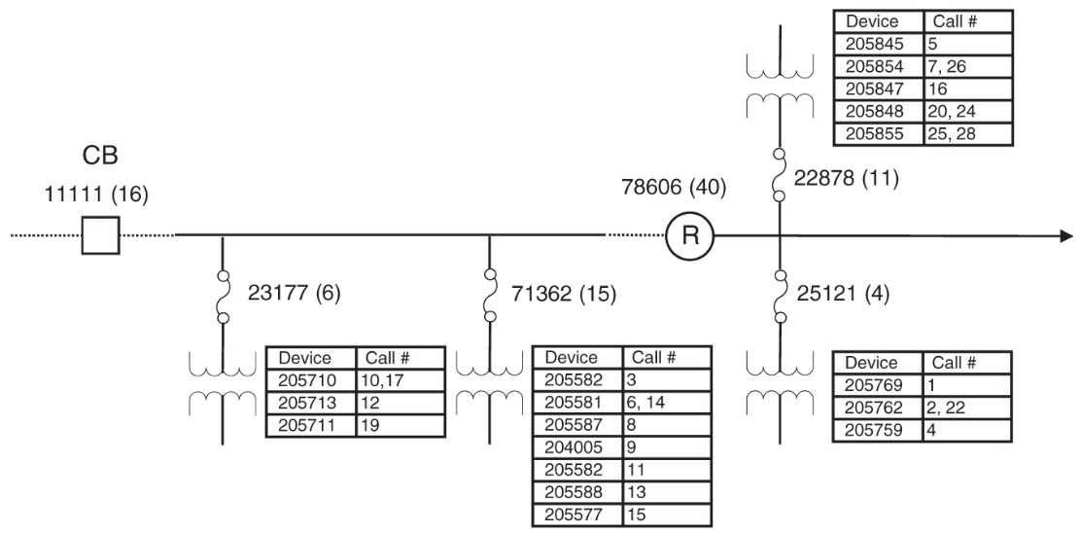
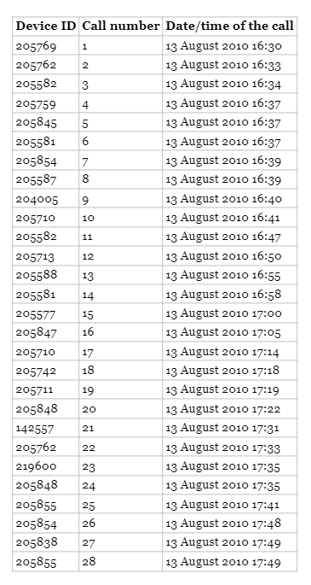
1.1.2 Test Cases
Table 3: Calls log
Fig. 3 Circuit diagram and call scenario for 13 August 2010
Above figure illustrates another example of trouble calls due to the operation of multiple protective devices within the same period.
Table 3 provides the call log for this example.
ECpE Department

Slide 36
1.1.2 Test Cases
Table 3: Calls log
Each feeder downstream of the fuse serves multiple transformers, but in this figure only one downstream transformer is shown, to keep the figure simple.
A table next to each transformer lists the transformers associated with the customer calls. For example, fuse 22878 serves 11 transformers below it, but only five are listed in the table because trouble calls were received only from customers served by these transformers.
ECpE Department

Slide 37
1.1.2 Test Cases
Table 3: Calls log
While applying the escalation rules, we note that customers associated with three of the six devices below 23177 are reporting an outage, and thus, the status of 23177 is changed to “1” because the calls exceed the threshold.
Customers from seven of the 15 devices below 71362 are reporting an outage, and thus, the status of 71362 is changed to “1.”
ECpE Department

Slide 38
1.1.2 Test Cases
Table 3: Calls log
Similarly, the remaining calls are processed, and the status of 25121 and 22878 are changed to “1.”
Now, we escalate these outages to the higher level to see if the status of any Level 1 device needs to be changed.
Flagged devices 23177 and 71362 are two of the 16 devices below 11111, which give 12.5%.
Since this is below the threshold, the status of 11111 remains “0.”
ECpE Department

Slide 39
1.1.2 Test Cases
Table 3: Calls log
Similarly, flagged devices 25121 and 22878 do not exceed the threshold of 78606, and their status also remains “0.”
Hence, the calls are grouped into four groups with devices 22878, 23177, 71362, and 25121 as the operated protective devices.
These devices are the same as those reported by the utility as the operated devices. Since this is below the threshold, the status of 11111 remains “0.”
ECpE Department

Slide 40
1.1.2 Test Cases
Table 3: Calls log
Note that call # 18, 21, 23, and 27 are single calls from other devices, and they do not get grouped with other calls.
ECpE Department

Slide 41
1.3 Voltage and VAr Control
Maintaining voltages within limits and providing proper utilization voltage to all customers under varying load conditions is a crucial task for utilities.
Consideration needs to be given to customers located at both the beginning and the end of the feeder.
Since the load changes throughout the day, utilities must continuously monitor the voltage and take corrective actions as needed.
Three levels of voltage regulation are commonly utilized: load tap changers (LTC) at the substation transformer, line regulators, and capacitors at specific locations in the system.
ECpE Department

Slide 42
1.3 Voltage and VAr Control
LTC and regulators are widely used and effective, but they have certain limitations.
The LTC and regulators primarily respond to local conditions and lack coordination between each other.
There is no direct coordination between LTCs/regulators and capacitors.
Improved coordination between voltage regulation devices can enhance the overall effectiveness of the system.
ECpE Department

Slide 43
1.3.1 Load Tap Changer
LTC (Load Tap Changer) is a mechanical device installed in transformers to adjust the number of windings by moving the tap up or down.
LTC responds to the load on the feeder and adjusts the tap position to increase voltage under heavy load and decrease voltage under light load conditions.
LTCs are custom designed to meet the specific needs of individual utilities.
Mechanical LTC controls offer limited options, while modern digital tap changer controls provide more flexibility.
Digital tap changer controls offer adjustable bandwidths around the nominal voltage and time delays for tap operation initiation.
ECpE Department

Slide 44
1.3.1 Load Tap Changer
Bandwidth determines the voltage range within which the LTC remains inactive, while time delay prevents frequent tap operations.
LTCs are designed for a specific number of operations, with many utilities specifying 500,000 operations before contact replacements.
With a typical life span of 40 years, LTCs can handle around 34 operations per day without the need for contact replacements.
ECpE Department

Slide 45
1.3.1 Load Tap Changer
In practice, the actual number of LTC operations is often lower than the specified limit.
LTC's operation can be controlled based on either the voltage measured on the feeder gateway at the substation or on an estimated voltage at a specified point on the feeder.
LTC’s operation control based on an estimated voltage at a specified point on the feeder is done using a technique called Line-drop compensation. It uses a model to represent the impedance of the feeder up to the point of control in conjunction with a voltage regulating relay that controls the taps.
ECpE Department

Slide 46
1.3.2 Line Regulators
Regulators are autotransformers that provide voltage control similar to LTCs but are physically separate from transformers.
Regulators operate within a ±10% voltage range and offer control in 32 steps of 5/8%.
They can be either three or single phase and located in the substation or on the feeders.
The ones that are designed for feeders are small in size and are mounted on the poles.
If a system is well designed with proper selection of conductors for the feeders to match the loading, it should not need any line regulators.
ECpE Department

Slide 47
1.3.2 Line Regulators
These are typically used in rural systems with very long feeders or in systems that have had an unexpected load growth in a specific part of the system. In this case, line regulators are a cost-effective way to address voltage-related issues without having to upgrade the whole feeder.
Control of regulators is done based on the voltage at the regulator or at a specific point in conjunction with line‐drop compensation.
Control of regulators is done based on the voltage at the regulator or at a specific point in conjunction with line‐drop compensation.
ECpE Department

Slide 48
1.3.2 Line Regulators
A major limitation both with LTC and regulators is that they only respond to voltage either next to them or at the regulated point.
There is very little or no coordination between their operation and those of the capacitors.
As a result, the system operates in a suboptimal state most of the times. Further, by design, they can only provide coarse control of voltage.
ECpE Department

Slide 49
1.3.3 Capacitors
Capacitors are used in distribution systems to inject reactive power for voltage control, power factor correction, and loss reduction.
Capacitors can be fixed or switched. Usually, the need for capacitors increases with increase in load.
Therefore, fixed capacitors are installed to meet reactive power needs under low load conditions,
While additional capacitors are switched on in steps as load increases and switched off in steps as load decreases.
ECpE Department

Slide 50
1.3.3 Capacitors
Voltage, reactive power, and power factor provide a direct way to control capacitors because an increase in load will create changes in these variables.
Traditional measurement of voltage, reactive power, and power factor was done locally near capacitors, but distribution automation enables measurements at different locations for improved control.
With larger number of measurements from the system, more coordinated and precise control of capacitors can be obtained.
Capacitors, however, should not be switched on very often because every switching operation generates a spike of current.
ECpE Department

Slide 51
1.3.3 Capacitors
Therefore, frequent operation can lead to failure of the switch controlling it or the failure of the capacitor itself.
Capacitor switching has also shown to create power quality issues including harmonics.
Devices such as STATCOM (static compensator) provide much better and precise control, but they are significantly more expensive. Therefore, they are used only in very special situations.
The number of capacitors as well as their sizes and locations to provide adequate voltage and var control is an important issue to consider. Obviously, not every bus in the system needs to have a capacitor. This topic is explored further in the following section.
ECpE Department

Slide 52
1.3.4 Capacitors Placement
Optimal placement of capacitors in a distribution system is a combinatorial optimization problem, which falls into the class of discrete optimization problems.
The amount of reactive power compensation required on a distribution system at any given time depends on the amount of load at that time.
Though the instantaneous load on the system exhibits large fluctuations, load aggregated over a period of time, such as one‐hour, shows smooth characteristics.
Typically, capacitors are not switched to follow the rapid fluctuations in the load, but in response to hourly load fluctuations over a period of time.
ECpE Department

Slide 53
1.3.4 Capacitors Placement
Since load fluctuates every hour, and with the seasons, the best solution for a given hour obviously will not be the best for another hour.
So we look for a solution which is the best over a specified period of time covering different ranges of loads.
This solution in turn provides the best locations for placing capacitors. A common practice is to use the load duration curve for a year.
ECpE Department

Slide 54
1.3.4 Capacitors Placement
The objective function for capacitor placement includes losses, voltage profile improvement, power factor improvement, load balance, and any combination of these factors depending on the priorities of the utility.
In the discussion that follows, the problem has been formulated for minimizing the cost of losses. The objective function is modeled to include three cost components:
(i) cost equivalent of peak power losses in the system,
(ii) energy costs for losses in the system at all load levels, and
(iii) cost for installing and maintaining the capacitors.
ECpE Department

Slide 55
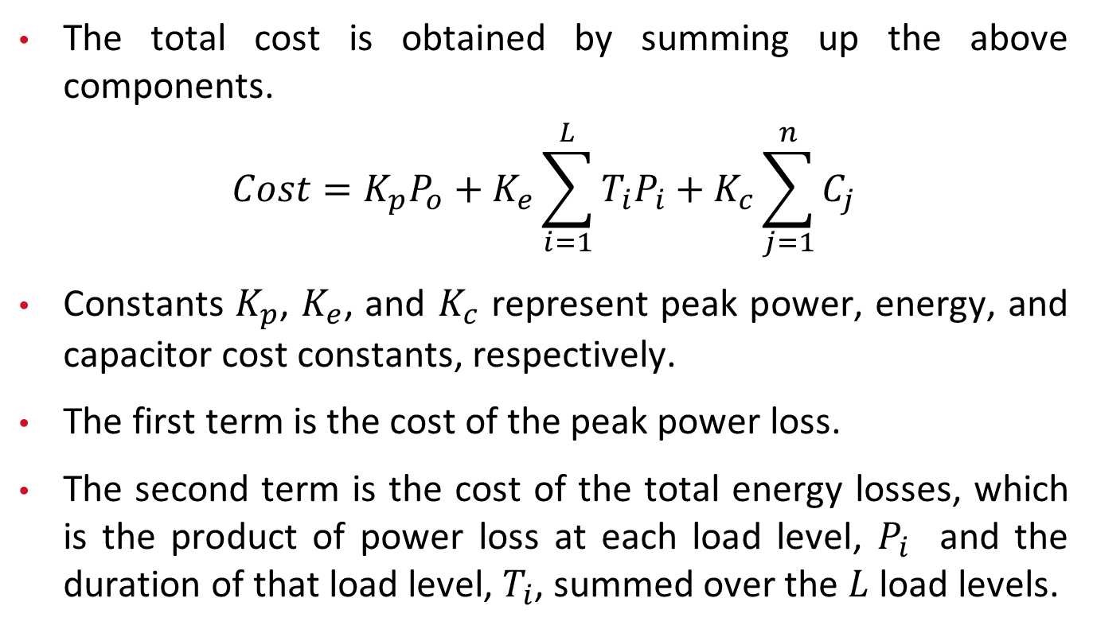
1.3.4 Capacitors Placement
The total cost is obtained by summing up the above components.
$$Cost=K_{p}P_{o}+K_{e}\sum_{i=1}^{L}{T_{i}P_{i}}+K_{c}\sum_{j=1}^{n}{C_{j}}$$
Constants $K_{p}$, $K_{e}$, and $K_{c}$ represent peak power, energy, and capacitor cost constants, respectively.
The first term is the cost of the peak power loss.
The second term is the cost of the total energy losses, which is the product of power loss at each load level, $P_{i}$ and the duration of that load level, $T_{i}$, summed over the $L$ load levels.
ECpE Department

Slide 56
1.3.4 Capacitors Placement
The third term is the cost of capacitor installations. The cost of capacitor installations is evaluated in terms of $/kVAr.
In this problem formulation, only the cost of capacitor purchase and installation is considered. The recurring cost for capacitor bank switching and maintenance is ignored for the sake of simplicity.
ECpE Department

Slide 57
1.3.4 Capacitors Placement
This optimization problem has traditionally been solved using various mathematical programming techniques including nonlinear, integer, and dynamic programming.
Many authors have incorporated heuristics in analytic methods to simplify the problem solution.
Intelligent techniques for capacitor placement reported in the literature include neural networks, simulated annealing, fuzzy logic, genetic algorithms, particle swarm optimization, ant colony optimization (ACO), tabu search strategy, and other evolutionary techniques.
ECpE Department

Slide 58
1.3.5 Capacitors Switching and Control
In the previous slides, we examined the problem of placement of capacitors at optimal locations.
Since the method was based on load duration curve and conforming loads, the determined locations will not be optimal under all conditions.
However, we cannot expect to change locations for different conditions.
Therefore, the capacitors installed at predetermined locations must be switched on or off based on the loading conditions to optimize a specified objective, which could be loss reduction, voltage boost, or power factor improvement in the system.
ECpE Department

Slide 59
1.4 Distribution System Reconfiguration
Distribution systems are structurally meshed but are operated in a radial configuration.
The system has a set of switches, called sectionalizing switches that normally remain closed, and another set of switches, called tie switches that are normally open.
The configuration of a distribution network can be modified by changing the status of the tie and the sectionalizing switches.
The process of changing the topology of distribution systems by altering the open/closed status of these switches is called distribution system reconfiguration.
Reconfiguration is done in normal operation to operate the system optimally.
ECpE Department

Slide 60
1.4 Distribution System Reconfiguration
In emergencies, after loss of power to a certain part of the system, reconfiguration is done to restore power quickly to customers whose power supply has been interrupted. The goals are different, but the process is the same.
Mathematically, distribution system reconfiguration problem is a complex, combinatorial optimization problem involving constraints.
The complexity of the problem arises from the fact that distribution network topology has to be radial, and power flow constraints are nonlinear in nature.
Since a typical distribution system may have hundreds of switches, an exhaustive search of all possible configurations is not a practical solution.
Therefore, many of the algorithms in the literature are based on heuristic search techniques or artificial intelligence techniques.
ECpE Department

Slide 61
1.4.1 Multi-Objective Reconfiguration Problem
Several different objectives can be included in multi-objective distribution system reconfiguration problem.
Multi-objective distribution system reconfiguration involves optimizing multiple objectives simultaneously.
Common objectives may include loss minimization, load balancing on transformers, and voltage deviation from nominal.
Under emergencies, loss minimization is not important, but the number of switching operations to complete restoration could be included as an objective.
ECpE Department

Slide 62
1.4.1 Multi-Objective Reconfiguration Problem
In the following discussion, we have considered three separate objectives, which are system loss, transformer load balance, and voltage deviation from nominal.
In multi-objective optimization, it is possible to compare two solutions using the concept of dominance.
Without loss of generality, if we assume that the optimization problem involves minimization of the objective functions, then a solution x* ∈ Ω, where Ω is the set of all x that satisfy all constraints, is said to be Pareto Optimal if and only if there does not exist another solution x ∈ Ω such that f_{i}(x) ≤ f_{i}(x*) for all i = 1, …, k and f_{i}(x) < f_{i}(x*) for at least one i.
ECpE Department

Slide 63
1.4.1 Multi-Objective Reconfiguration Problem
When comparing two solutions, a solution u is said to dominate over another solution v, if, and only if, u is at least as good as v for all the objectives, and if there is at least one objective where u is better than v.
In a solution space, the set of all nondominated solutions is referred to as the Pareto set.
The goal of the multi-objective optimization algorithm is to extract diverse samples from this set.

Slide 64
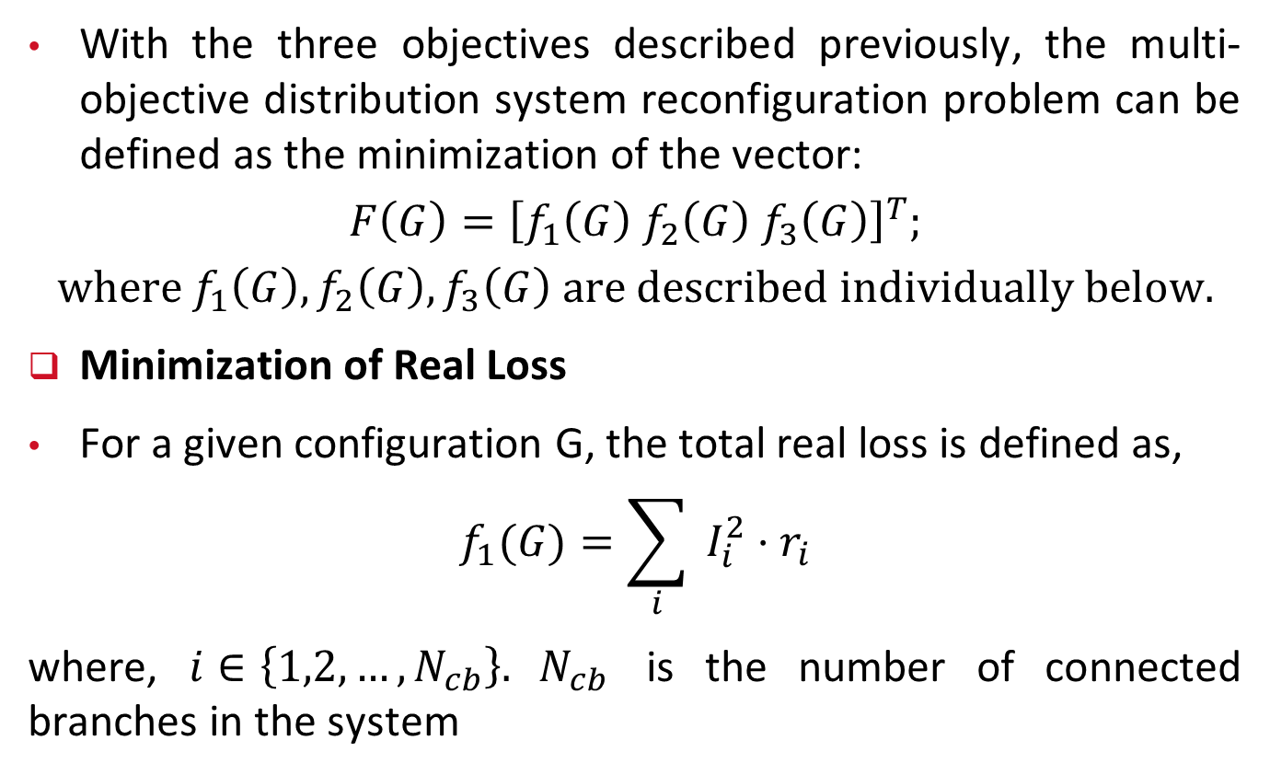
1.4.1 Multi-Objective Reconfiguration Problem
With the three objectives described previously, the multi-objective distribution system reconfiguration problem can be defined as the minimization of the vector:
$$F\left(G\right)={\left[f_{1}\left(G\right) f_{2}\left(G\right) f_{3}\left(G\right)\right]}^{T};$$
$$where f_{1}\left(G\right), f_{2}\left(G\right), f_{3}\left(G\right) are described individually below.$$
Minimization of Real Loss
For a given configuration G, the total real loss is defined as,
$$f_{1}(G)=\sum_{i}{ }I_{i}^{2}⋅r_{i}$$
where, $i∈\left\{1,2,…,N_{cb}\right\}. N_{cb}$ is the number of connected branches in the system
ECpE Department

Slide 65
1.4.1 Multi-Objective Reconfiguration Problem
Transformer Load Balancing
Loading on the substation transformers is balanced only when the load shared by each transformer in a distribution system is proportional to the capacity of that transformer. This loading is called ideal loading.
The ideal loading is calculated by multiplying the fractional capacity of a transformer with the sum of the total loss and load (in MVA) on the network.
Fractional capacity of a transformer is equal to the ratio between the transformer capacity and the sum of capacities of all transformers in the system.
ECpE Department

Slide 66
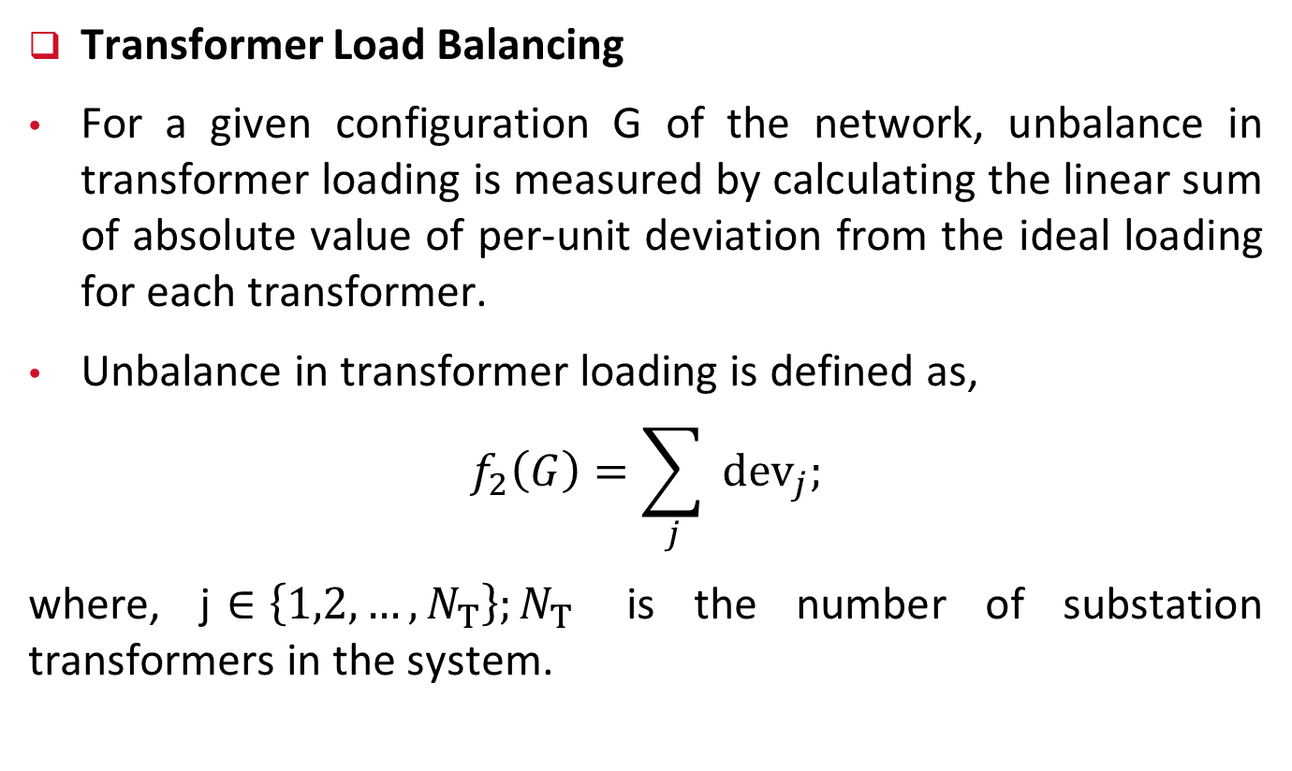
1.4.1 Multi-Objective Reconfiguration Problem
Transformer Load Balancing
For a given configuration G of the network, unbalance in transformer loading is measured by calculating the linear sum of absolute value of per‐unit deviation from the ideal loading for each transformer.
Unbalance in transformer loading is defined as,
$$f_{2}\left(G\right)=\sum_{j}{ }{dev}_{j};$$
where, j$∈\left\{1,2,…,N_{T}\right\};N_{T}$ is the number of substation transformers in the system.
ECpE Department

Slide 67
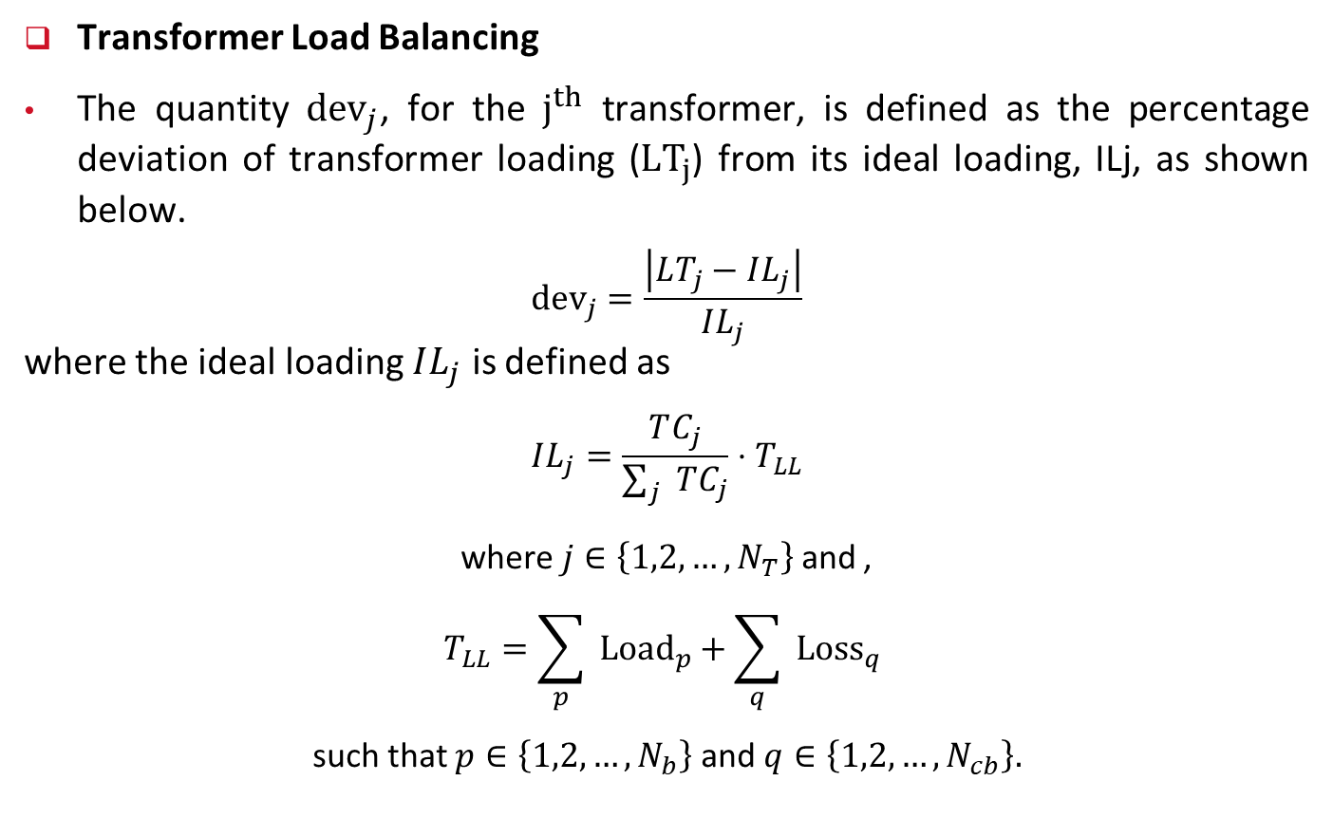
1.4.1 Multi-Objective Reconfiguration Problem
Transformer Load Balancing
The quantity ${dev}_{j}$, for the $j^{th}$ transformer, is defined as the percentage deviation of transformer loading (${LT}_{j}$) from its ideal loading, ILj, as shown below.
$${dev}_{j}=\frac{\left|LT_{j}−IL_{j}\right|}{IL_{j}}$$
where the ideal loading $IL_{j}$ is defined as
$$IL_{j}=\frac{TC_{j}}{\sum_{j}{ } TC_{j}}⋅T_{LL}$$
where $j∈\left\{1,2,…,N_{T}\right\}$ and ,
$$T_{LL}=\sum_{p}{ }{Load}_{p}+\sum_{q}{ }{Loss}_{q}$$
such that $p∈\left\{1,2,…,N_{b}\right\}$ and $q∈\left\{1,2,…,N_{cb}\right\}.$
ECpE Department

Slide 68
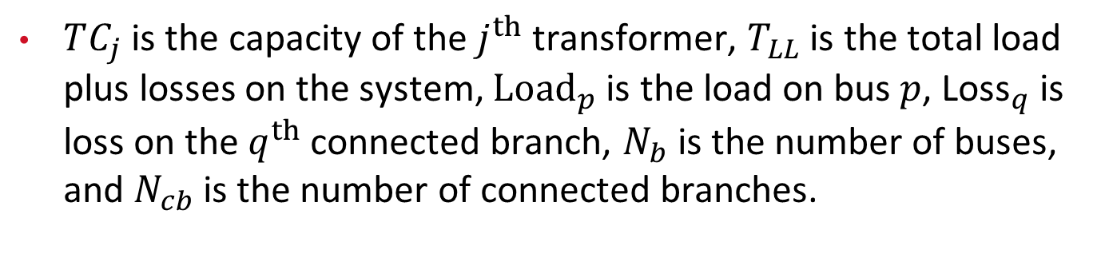
1.4.1 Multi-Objective Reconfiguration Problem
$TC_{j}$ is the capacity of the $j^{th}$ transformer, $T_{LL}$ is the total load plus losses on the system, ${Load}_{p}$ is the load on bus $p$, ${\text{Loss}}_{q}$ is loss on the $q^{th}$ connected branch, $N_{b}$ is the number of buses, and $N_{cb}$ is the number of connected branches.
ECpE Department

Slide 69

1.4.1 Multi-Objective Reconfiguration Problem
Minimization of Voltage Deviation
Voltage deviation from 1 per unit is defined as
$$f_{3}(G)=max\left\{\left|1−min\left(V_{i}\right)\right|,\left|1−max\left(V_{i}\right)\right|\right\}$$
where $i∈\left\{1,2,…,N_{b}\right\}$, and $V_{i}$ is the voltage on the $i$ bus.
ECpE Department

Slide 70
1.5 Distribution System Restoration
In Chapter 5, we had introduced the concept of cold load pickup (CLPU) and its impacts on the operation and planning of distribution systems.
In this slide, we revisit the topic and provide more details with a few illustrative examples.
Note that if the service interruption is of short duration, the enduring component of CLPU is not important during restoration.
However, if the interruption is long, the enduring component of CLPU can have significant impact, particularly in systems with high penetration of thermostatically controlled devices.
In such situations, step‐by‐step restoration, as discussed in the following section, may be required instead of restoration of all of the loads in one step.
ECpE Department

Slide 71
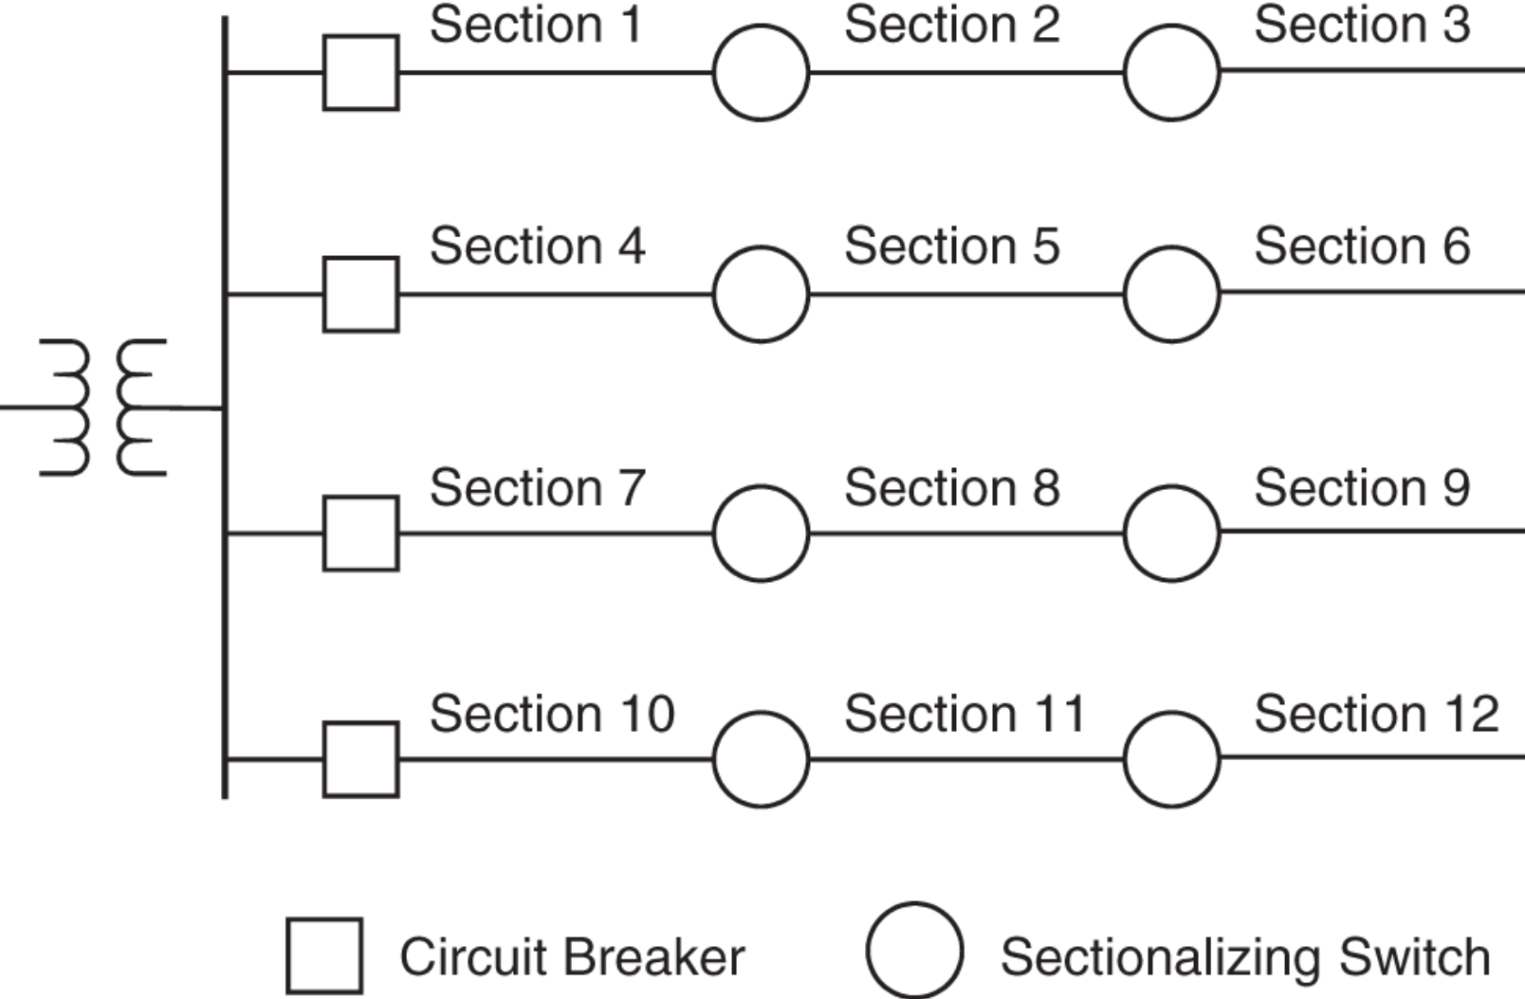
1.5.1 Step-by-Step Restoration
The distribution system depicted in the right-hand side figure features remotely controlled sectionalizing switches on the main feeders that can be opened and closed to supply power to the respective stations.
We assume that the total substation transformer capacity is not sufficient to switch on all the loads simultaneously due to system undiversified load resulting from long outage duration.
Fig: One-line diagram of a distribution system with 12 sections
ECpE Department

Slide 72
1.5.1 Step-by-Step Restoration
In general, loss of diversity depends on both the outage duration and outside temperature. For example, on a very hot summer day, even shorter outage durations may result in a complete loss of diversity because temperature inside the houses will increase faster to reach the ambient temperature, resulting in quicker diversity loss.
Fig: One-line diagram of a distribution system with 12 sections
ECpE Department

Slide 73
1.5.1 Step-by-Step Restoration
Typically, we can consider that the diversity will be completely lost if the outage lasts for more than half an hour.
Switching power to loads during CLPU is dependent on the transformer loading capacity.
If the loading capacity is exceeded, sections need to be restored sequentially.
Fig: One-line diagram of a distribution system with 12 sections
ECpE Department

Slide 74
1.5.1 Step-by-Step Restoration
Sections with priority loads such as hospital, fire station, and police station must be supplied power as soon as possible.
Priority loads are included in the restoration procedure as the priority constraints.
Also, if a section that needs to be supplied power is at the end of the feeder, then all the in‐between sections on that feeder must be supplied power first.
Fig: One-line diagram of a distribution system with 12 sections
ECpE Department

Slide 75
1.5.1 Step-by-Step Restoration
Thus, the selection of a section to restore power will require energizing the upstream sections on the feeder.
These types of constraints are called precedence constraints, which are unavoidable when a feeder is divided into sections with sectionalizing switches.
Fig: One-line diagram of a distribution system with 12 sections
ECpE Department

Slide 76
1.5.1 Step-by-Step Restoration
The flexibility of restoring power can be increased by installing single‐phase sectionalizing switches on the laterals.
In that case, loads on the laterals can be restored without any precedence restrictions.
The only restriction would be that the main feeders to which laterals are connected must have power before restoration can start.
Fig: One-line diagram of a distribution system with 12 sections
ECpE Department

Slide 77
1.5.1 Step-by-Step Restoration
Installing single‐phase sectionalizing switches increases flexibility but, on the other hand, complicates the restoration procedure, and the cost becomes prohibitive.
Since each lateral is connected to one phase, several switches on the laterals would have to be operated simultaneously to restore a section of the distribution system instead of one three‐phase switch on the main feeder.
Fig: One-line diagram of a distribution system with 12 sections
ECpE Department

Slide 78
1.5.1 Step-by-Step Restoration
Such a scheme for restoration based on single‐phase sections could be complicated and nonpractical.
In other words, the outcome of restoration based on this approach may not improve sufficiently to justify additional expenses and increased complexity.
Fig: One-line diagram of a distribution system with 12 sections
ECpE Department

Slide 79
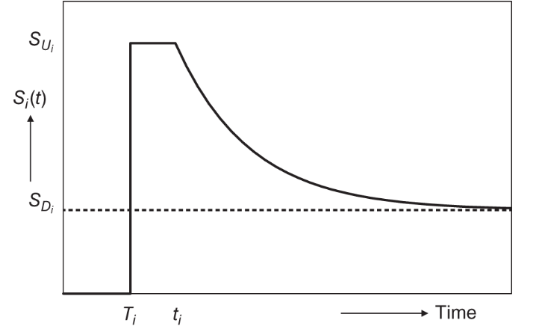
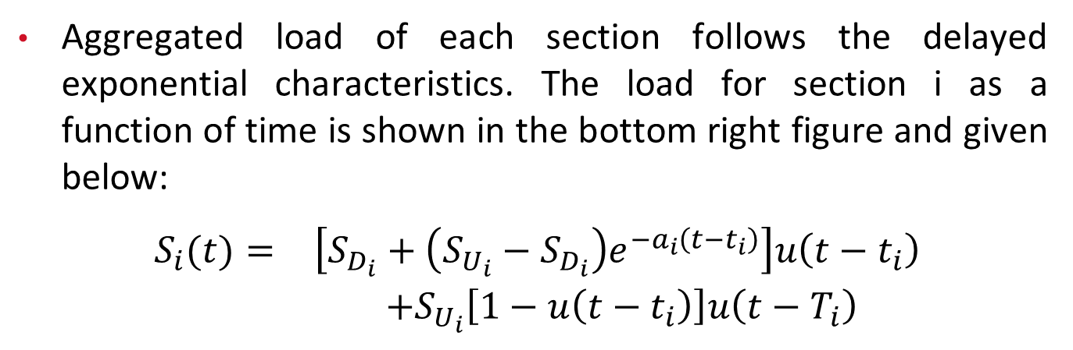
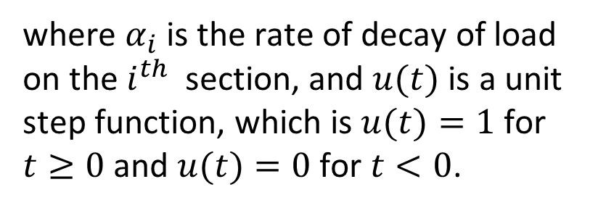
1.5.1 Step-by-Step Restoration
Aggregated load of each section follows the delayed exponential characteristics. The load for section i as a function of time is shown in the bottom right figure and given below:
$\begin{matrix}S_{i}(t)= & \left[S_{D_{i}}+\left(S_{U_{i}}−S_{D_{i}}\right)e^{−a_{i}\left(t−t_{i}\right)}\right]u\left(t−t_{i}\right) \\ & +S_{U_{i}}\left[1−u\left(t−t_{i}\right)\right]u\left(t−T_{i}\right)\end{matrix}$
where $α_{i}$ is the rate of decay of load on the $i^{th}$ section, and $u(t)$ is a unit step function, which is $u(t)=1$ for $t≥0$ and $u(t)=0$ for $t<0$.
Fig: Load of section i upon restoration following an extended outage
ECpE Department

Slide 80
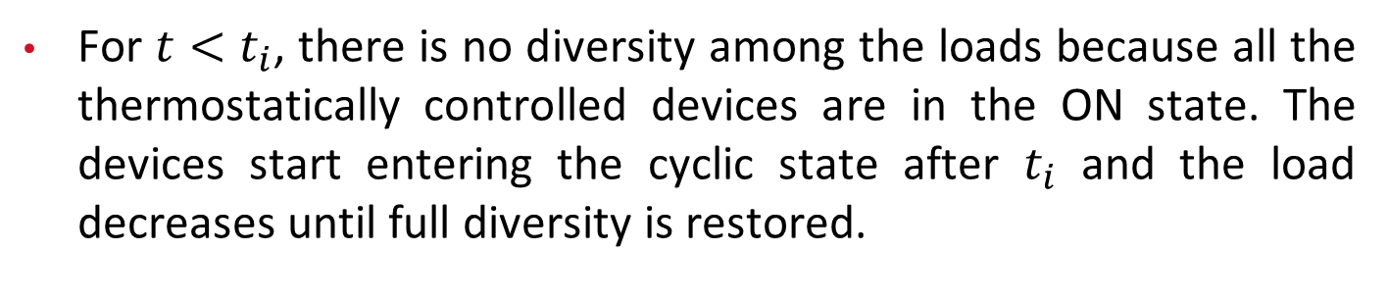
1.5.1 Step-by-Step Restoration
For $t<t_{i}$, there is no diversity among the loads because all the thermostatically controlled devices are in the ON state. The devices start entering the cyclic state after $t_{i}$ and the load decreases until full diversity is restored.
Fig: Load of section i upon restoration following an extended outage
ECpE Department

Slide 81
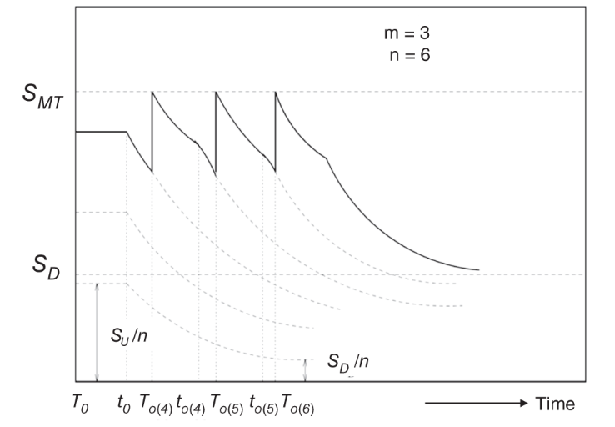
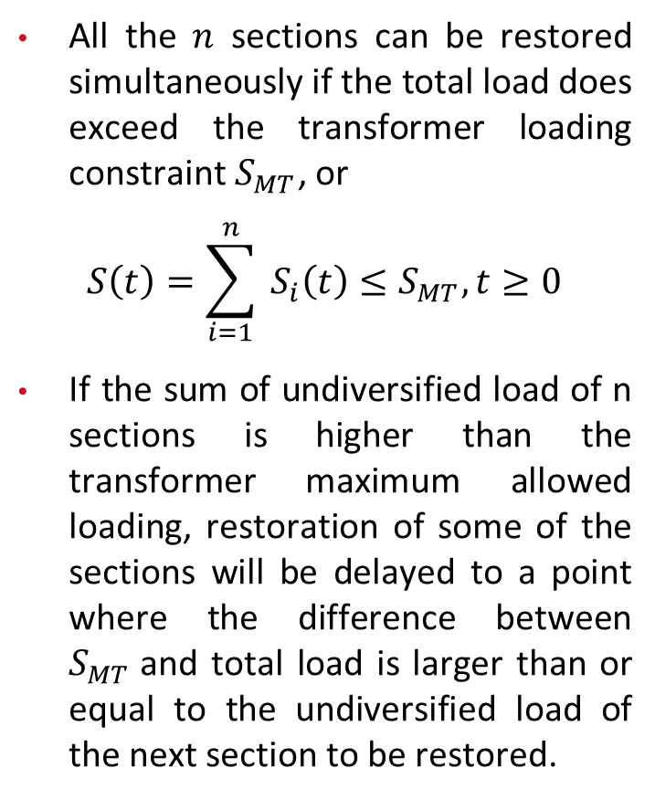
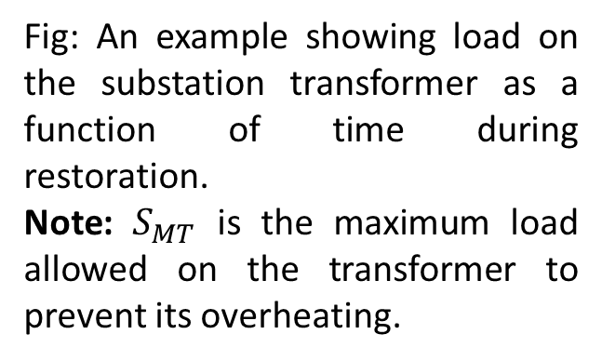
1.5.1 Step-by-Step Restoration
All the $n$ sections can be restored simultaneously if the total load does exceed the transformer loading constraint $S_{MT}$, or
$$S\left(t\right)=\sum_{i=1}^{n}{ }S_{i}\left(t\right)≤S_{MT}, t≥0$$
If the sum of undiversified load of n sections is higher than the transformer maximum allowed loading, restoration of some of the sections will be delayed to a point where the difference between $S_{MT}$and total load is larger than or equal to the undiversified load of the next section to be restored.
Fig: An example showing load on the substation transformer as a function of time during restoration.
Note: $S_{MT}$ is the maximum load allowed on the transformer to prevent its overheating.
ECpE Department

Slide 82
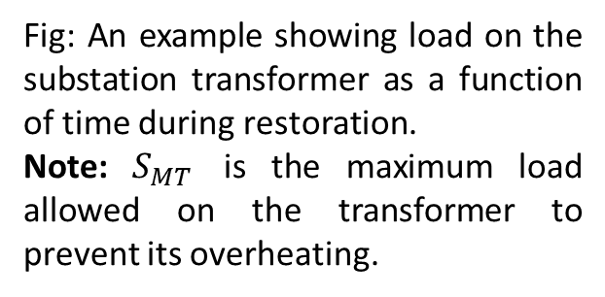
1.5.1 Step-by-Step Restoration
The figure on the right shows an example of restoration of a system with six identical sections. Three sections are restored at t=0, and the rest are restored step by step, while maintaining the loading constraints on the transformer.
Fig: An example showing load on the substation transformer as a function of time during restoration.
Note: $S_{MT}$ is the maximum load allowed on the transformer to prevent its overheating.
ECpE Department

Slide 83
1.5.2 Restoration Times
The time when a section is restored is called restoration time of that section, which depends on the restoration order.
To avoid confusion, it is essential to distinguish between the section numbers and an index associated with each section representing the restoration order.
Each section is represented with a number i, and its restoration is represented by "j," giving a relationship o(j) = i.
ECpE Department

Slide 84
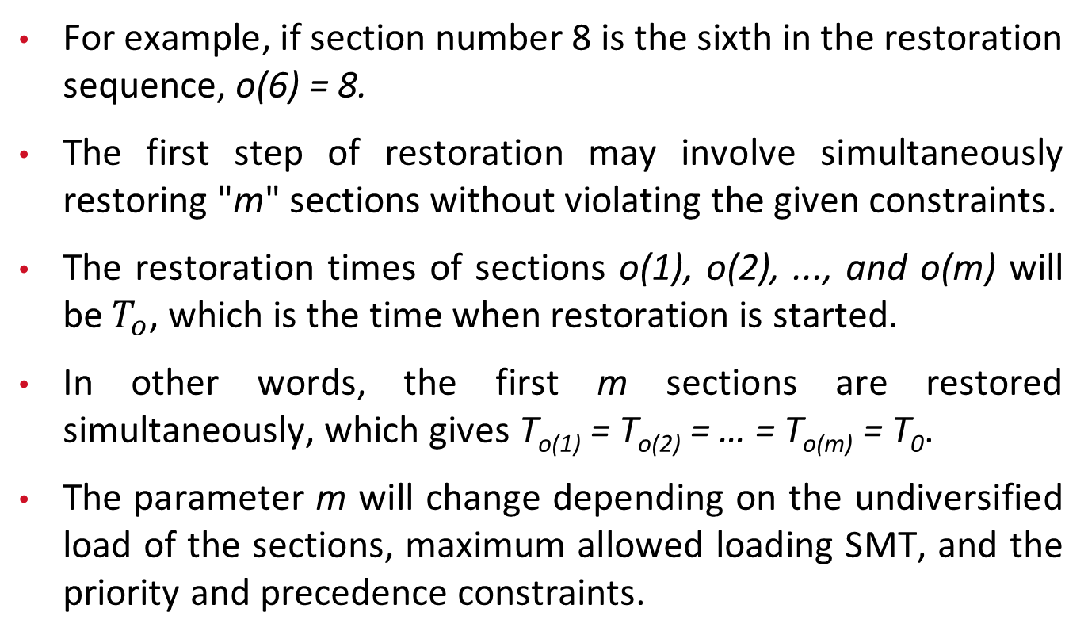
1.5.2 Restoration Times
For example, if section number 8 is the sixth in the restoration sequence, o(6) = 8.
The first step of restoration may involve simultaneously restoring "m" sections without violating the given constraints.
The restoration times of sections o(1), o(2), ..., and o(m) will be $T_{o}$, which is the time when restoration is started.
In other words, the first m sections are restored simultaneously, which gives T_{o(1)} = T_{o(2)} = … = T_{o(m)} = T₀.
The parameter m will change depending on the undiversified load of the sections, maximum allowed loading SMT, and the priority and precedence constraints.
ECpE Department

Slide 85
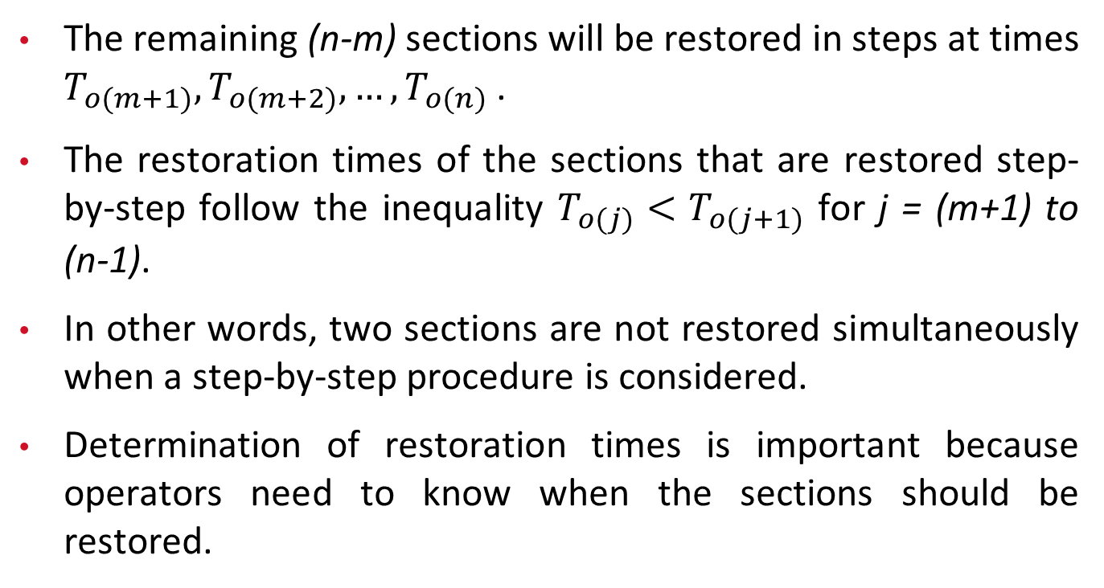
1.5.2 Restoration Times
The remaining (n-m) sections will be restored in steps at times $T_{o(m+1)},T_{o(m+2)},…,T_{o(n)}$.
The restoration times of the sections that are restored step-by-step follow the inequality $T_{o(j)}<T_{o(j+1)}$ for j = (m+1) to (n-1).
In other words, two sections are not restored simultaneously when a step‐by‐step procedure is considered.
Determination of restoration times is important because operators need to know when the sections should be restored.
ECpE Department

Slide 86
1.5.3 Derivation of Restoration Times
Load decay characteristics of each section are assumed to be approximately the same if the sections have similar loads and the system outage duration is long enough.
The dynamics of aggregate loads are expected to be similar after a long outage, as house temperatures reach ambient temperature, resulting in similar load behavior upon restoration.
This approximation may not hold if house characteristics vary significantly between sections.

Slide 87
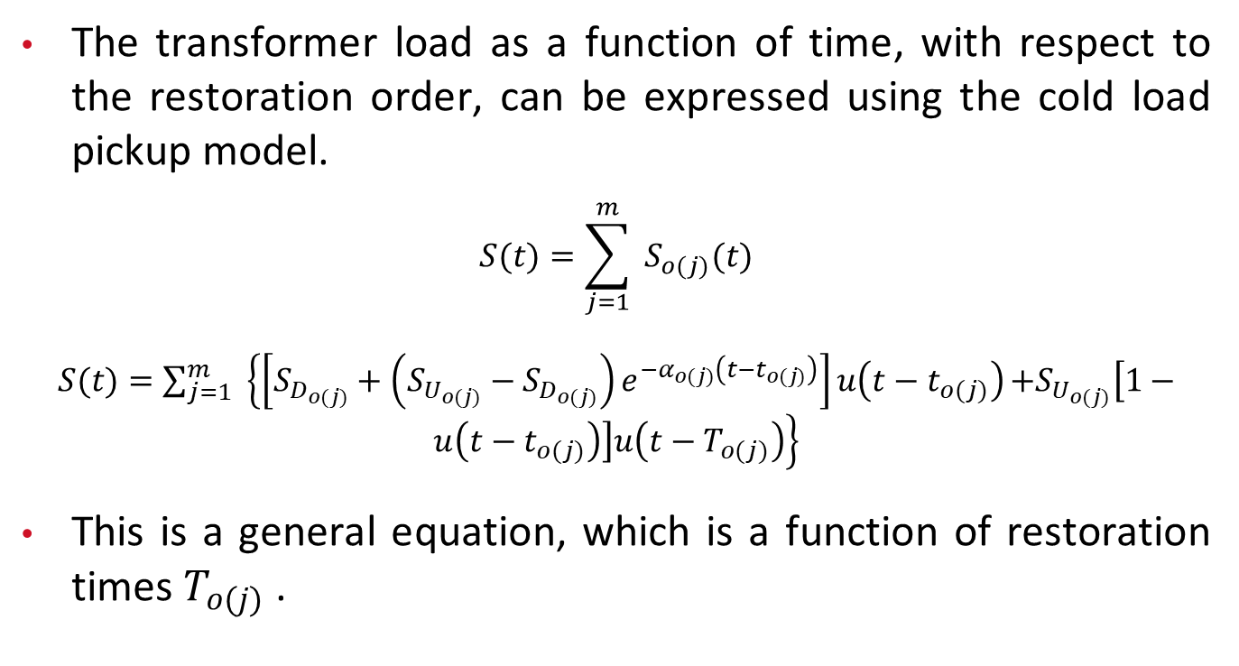
1.5.3 Derivation of Restoration Times
The transformer load as a function of time, with respect to the restoration order, can be expressed using the cold load pickup model.
$$S(t)=\sum_{j=1}^{m}{ } S_{o(j)}(t)$$
$S(t)=\sum_{j=1}^{m}{ } \left\{\left[S_{D_{o(j)}}+\left(S_{U_{o(j)}}−S_{D_{o(j)}}\right)e^{−α_{o(j)}\left(t−t_{o(j)}\right)}\right]u\left(t−t_{o(j)}\right)\right.\left.+S_{U_{o(j)}}\left[1−u\left(t−t_{o(j)}\right)\right]u\left(t−T_{o(j)}\right)\right\}$
This is a general equation, which is a function of restoration times $T_{o(j)}$ .

Slide 88
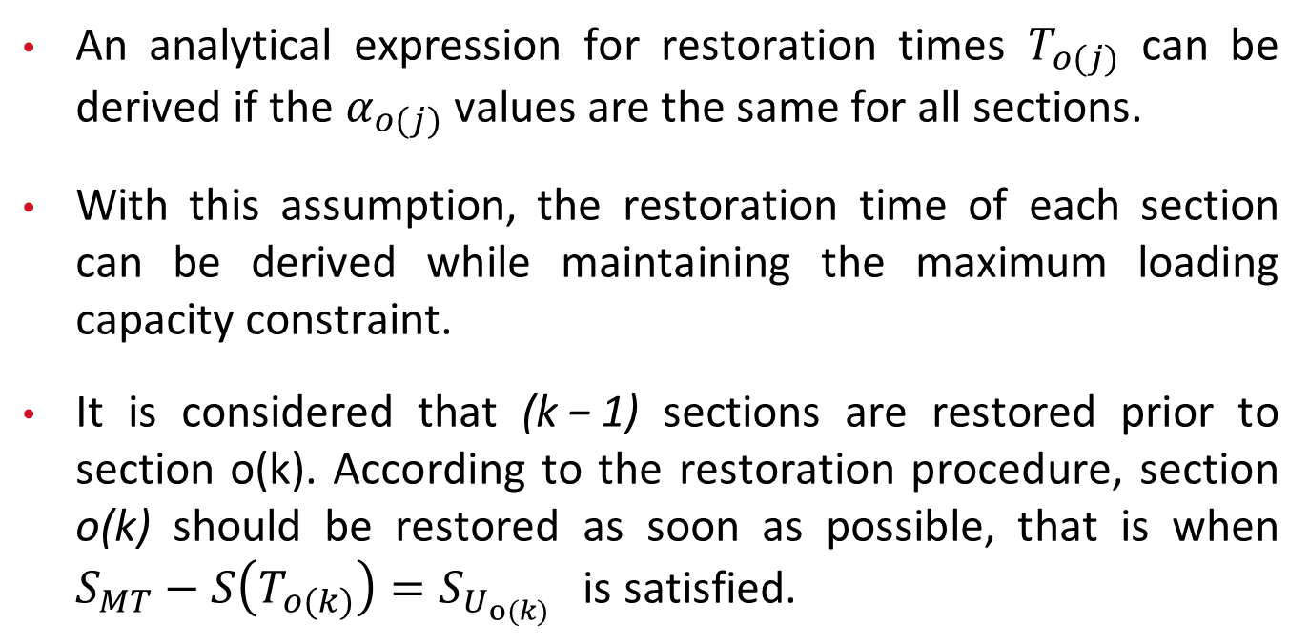
1.5.3 Derivation of Restoration Times
An analytical expression for restoration times $T_{o(j)}$ can be derived if the $α_{o(j)}$values are the same for all sections.
With this assumption, the restoration time of each section can be derived while maintaining the maximum loading capacity constraint.
It is considered that (k − 1) sections are restored prior to section o(k). According to the restoration procedure, section o(k) should be restored as soon as possible, that is when $S_{MT}−S\left(T_{o(k)}\right)=S_{U_{o(k)}}$ is satisfied.

Slide 89
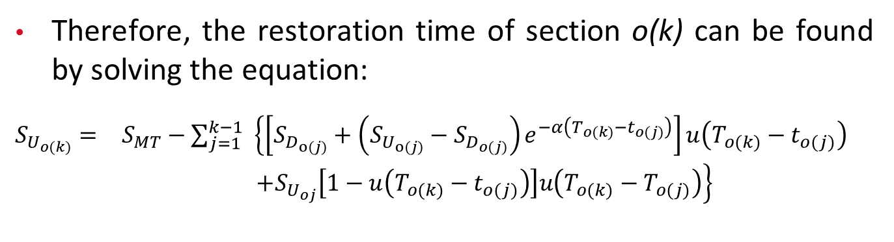
1.5.3 Derivation of Restoration Times
Therefore, the restoration time of section o(k) can be found by solving the equation:
$\begin{matrix}S_{U_{o(k)}}= & S_{MT}−\sum_{j=1}^{k−1}{ } \left\{\left[S_{D_{o(j)}}+\left(S_{U_{o(j)}}−S_{D_{o(j)}}\right)e^{−α\left(T_{o(k)}−t_{o(j)}\right)}\right]u\left(T_{o(k)}−t_{o(j)}\right)\right. \\ & \left.+S_{U_{oj}}\left[1−u\left(T_{o(k)}−t_{o(j)}\right)\right]u\left(T_{o(k)}−T_{o(j)}\right)\right\}\end{matrix}$

Slide 90
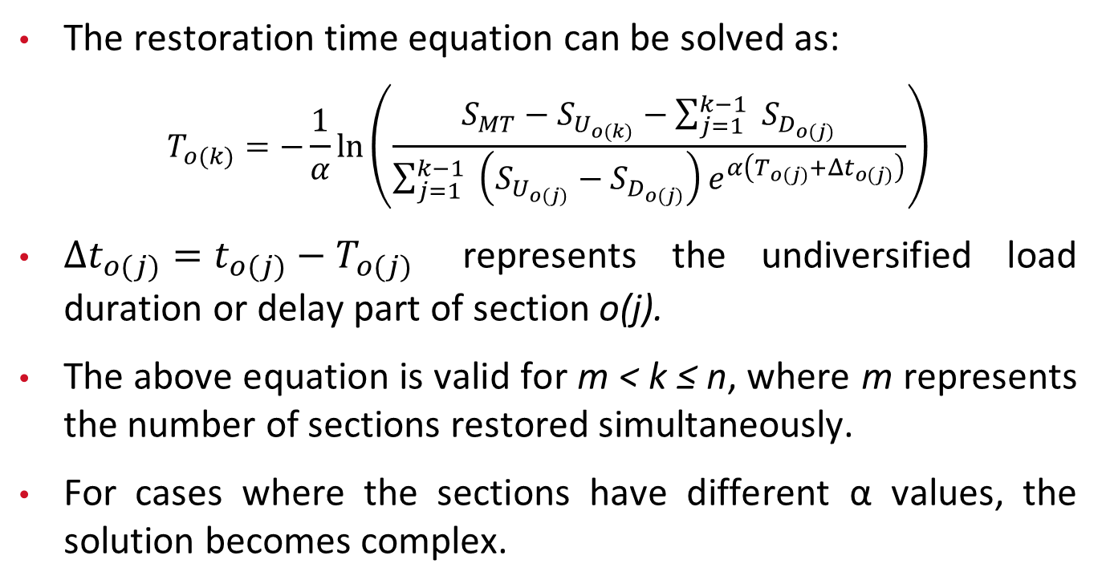
1.5.3 Derivation of Restoration Times
The restoration time equation can be solved as:
$$T_{o(k)}=−\frac{1}{α}ln⁡\left(\frac{S_{MT}−S_{U_{o(k)}}−\sum_{j=1}^{k−1}{ } S_{D_{o(j)}}}{\sum_{j=1}^{k−1}{ } \left(S_{U_{o(j)}}−S_{D_{o(j)}}\right)e^{α\left(T_{o(j)}+Δt_{o(j)}\right)}}\right)$$
$Δt_{o(j)}=t_{o(j)}−T_{o(j)}$ represents the undiversified load duration or delay part of section o(j).
The above equation is valid for m < k ≤ n, where m represents the number of sections restored simultaneously.
For cases where the sections have different α values, the solution becomes complex.

Slide 91
1.5.4 Optimal Operation and Design for Restoration During CLPU
Both the operation and the design of distribution systems are important to effectively address CLPU.
In a system with feeders of substantially different loads, proper sequence of sections to restore becomes important to minimize the restoration time.
Thus, an optimal sequence can be determined that requires the least time to restore all of them while meeting all the system constraints.
In addition, distribution systems can be designed to handle CLPU conditions while considering transformer loading and voltage drop on feeders.
In this section, we give two examples to further explain the concepts.

Slide 92
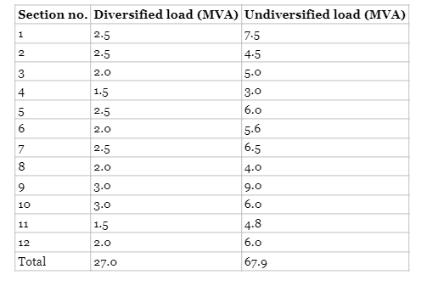
1.5.4.1 Thermally Limited System
Fig: One-line diagram of a distribution system with 12 sections
Table: Diversified and undiversified loads of sections of the example system.
Example: Thermally limited distribution system (The Figure in the left-hand side)
Assumption: Feeders are not very long (true for urban areas), voltage drop is not a problem, and thermal limits of the feeders are not considered.

Slide 93
1.5.4.1 Thermally Limited System
Fig: One-line diagram of a distribution system with 12 sections
Table: Diversified and undiversified loads of sections of the example system.
The diversified and undiversified loads of the feeder sections are given in the table.
Transformer rating: 30 MVA under forced oil circulation (FOA) conditions
Maximum loading allowed during restoration: 45 MVA
Delay part in the cold load pickup model for each section: 20 minutes

Slide 94
1.5.4.1 Thermally Limited System
Fig: One-line diagram of a distribution system with 12 sections
Table: Diversified and undiversified loads of sections of the example system.
The results obtained from a search showed that the minimum time needed to complete restoration without violating the transformer loading limit is 83 minutes, and the maximum time is 93 minutes.

Slide 95
1.5.4.1 Thermally Limited System
Fig: One-line diagram of a distribution system with 12 sections
Table: Diversified and undiversified loads of sections of the example system.
Order of restoration of sections for minimum time: 10, 11, 12, 7, 8, 9, 1, 4, 5, 6, 2, 3
In another case, change in maximum loading on the transformer (reduced to 36 MVA) which changed the maximum and minimum time for restoration.
New maximum time needed for restoration: 195 minutes
New minimum time needed for restoration: 168 minutes

Slide 96
1.5.4.1 Thermally Limited System
Fig: One-line diagram of a distribution system with 12 sections
Table: Diversified and undiversified loads of sections of the example system.
Updated order of restoration of sections for minimum time: 10, 7, 8, 9, 4, 11, 1, 5, 12, 6, 2, 3

Slide 97
1.5.4.2 Voltage Drop Limited System
Example: Semiurban system with long lines and significant voltage drops during restoration due to CLPU.
Focus: Finding optimal switch locations based on voltage drop
System characteristics:
Service area: Triangular shape with uniform load density
Main feeder: Three different conductor sizes, largest near the substation, tapering off away from the substation along with load reduction
Voltage level | 12.47 kV
Service area per feeder | 2 sq-miles
Load density | 3.61 MVA/sq-miles
Substation spacing | 4.56 miles
Main feeder length | 3.4 miles
Feeders per transformer | 3
Conductors used for feeders | 636 kcmil 4/0, and #2
Frequency of CLPU events | 0.2/yr
Table: Input Data for the voltage drop limited distribution systems
Transformer capacity | 30 MVA
Distance of the first switch from the substation | 1.86 miles
Distance of the second switch from the substation | 2.12 miles
Restoration time of the first switch | 30 min
Restoration time of the second switch | 59.29 min
Table: Results for the voltage drop limited distribution systems

Slide 98
1.5.4.2 Voltage Drop Limited System
All feeders: Identical with undiversified load equal to four times the diversified load
Study duration: 30 years for cost calculations
Summary of results in bottom right Table. :
Provides information on optimal switch locations and corresponding voltage drop values
Helps in determining the best places to locate switches for effective restoration in the semiurban system.
Voltage level | 12.47 kV
Service area per feeder | 2 sq-miles
Load density | 3.61 MVA/sq-miles
Substation spacing | 4.56 miles
Main feeder length | 3.4 miles
Feeders per transformer | 3
Conductors used for feeders | 636 kcmil 4/0, and #2
Frequency of CLPU events | 0.2/yr
Table: Input Data for the voltage drop limited distribution systems
Transformer capacity | 30 MVA
Distance of the first switch from the substation | 1.86 miles
Distance of the second switch from the substation | 2.12 miles
Restoration time of the first switch | 30 min
Restoration time of the second switch | 59.29 min
Table: Results for the voltage drop limited distribution systems

Slide 99
1.5.4.2 Voltage Drop Limited System
Voltage level | 12.47 kV
Service area per feeder | 2 sq-miles
Load density | 3.61 MVA/sq-miles
Substation spacing | 4.56 miles
Main feeder length | 3.4 miles
Feeders per transformer | 3
Conductors used for feeders | 636 kcmil 4/0, and #2
Frequency of CLPU events | 0.2/yr
The examples provided are specific to the systems considered and serve as illustrations.
Results for other systems will vary but are expected to follow similar trends.
Table: Input Data for the voltage drop limited distribution systems
Transformer capacity | 30 MVA
Distance of the first switch from the substation | 1.86 miles
Distance of the second switch from the substation | 2.12 miles
Restoration time of the first switch | 30 min
Restoration time of the second switch | 59.29 min
Table: Results for the voltage drop limited distribution systems

Slide 100
1.5.4.2 Voltage Drop Limited System
The models of cold load pickup used in the analysis are based on field observations and simulations.
Obtaining additional real data from the field during restoration after long interruptions is crucial for further advancements in understanding cold load pickup.
Voltage level | 12.47 kV
Service area per feeder | 2 sq-miles
Load density | 3.61 MVA/sq-miles
Substation spacing | 4.56 miles
Main feeder length | 3.4 miles
Feeders per transformer | 3
Conductors used for feeders | 636 kcmil 4/0, and #2
Frequency of CLPU events | 0.2/yr
Table: Input Data for the voltage drop limited distribution systems
Transformer capacity | 30 MVA
Distance of the first switch from the substation | 1.86 miles
Distance of the second switch from the substation | 2.12 miles
Restoration time of the first switch | 30 min
Restoration time of the second switch | 59.29 min
Table: Results for the voltage drop limited distribution systems

Slide 101
Thank You!

